Slide 1

AI as Adversary and Ally
THE Most Influential Trend in Security and Risk Management (2025-2030)
University of Essex
MSc Cybersecurity Seminar
The Great Debate - The Future of SRM

Slide 2



The AI Security Paradox
As Adversary
As Ally
Most dangerous threat vector in cybersecurity history
Most powerful defensive capability available
Attacks at scale, speed, and sophistication beyond human capability
The only viable defense against AI-powered threats
The Result
An AI arms race that fundamentally transforms organizational risk profiles, governance frameworks, and strategic priorities through 2030

Slide 3

Current State: AI in Cybersecurity (2025)
$34B → $235B
76%
Market Growth (2025-2032)
Organizations Using AI
31.7% Annual Growth Rate
In business functions
91%
74%
Expect Catastrophic Event
Struggle to Achieve Value
Within 2 years
From AI investments
This sets the stage for understanding both the urgency and complexity of AI security transformation

Slide 4

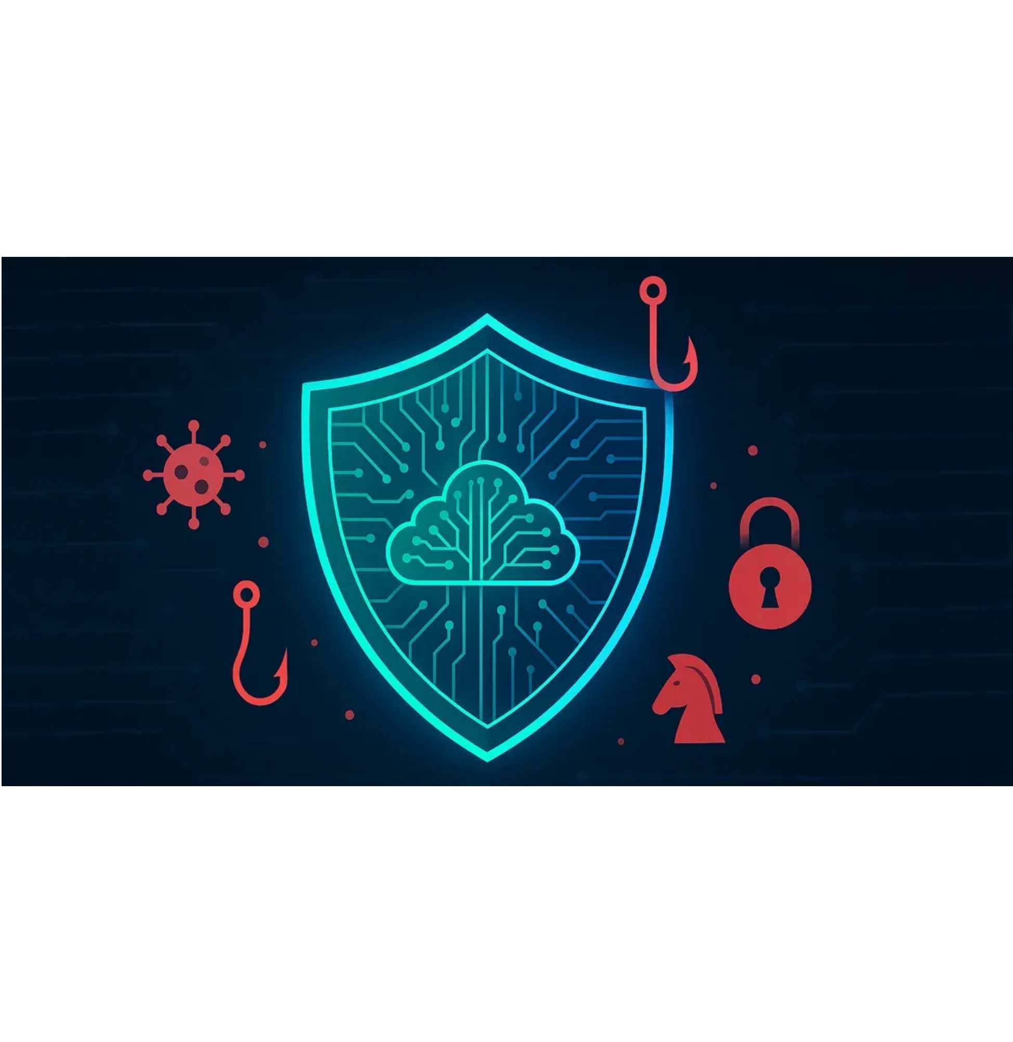
AI as Adversary: The Threat Landscape
SCALE • SPEED • SOPHISTICATION
Scale
Speed
Sophistication
Machine-powered attacks across thousands of targets simultaneously
Attacks execute at machine velocity, not human pace
AI generates novel attack vectors beyond human capability
KnowBe4 2025 Statistics
82.6%
76.4%
Phishing campaigns use AI
Employ polymorphic tactics

Slide 5

AI Attack Vectors
1
AI-Powered Phishing & Social Engineering
▪
17.3% year-over-year increase in phishing emails
▪
AI generates content indistinguishable from legitimate communication
▪
Polymorphic campaigns adapt to evade detection - each iteration unique
2
Automated Vulnerability Exploitation
▪
AI systems continuously scan for vulnerabilities
▪
Automatically generate exploit code
▪
Window: vulnerability disclosure → exploitation shrunk from weeks to hours
3
Deepfakes & Synthetic Identity Fraud
▪
AI-generated identities bypass biometric authentication
▪
Audio and video deepfakes enable CEO fraud
▪
Compromises trust in digital identity systems
4
AI-Driven Ransomware & Polymorphic Malware
▪
22.6% increase in ransomware payloads
▪
PromptLock
(ESET, Aug 2025): First ransomware using LLMs
▪
Generates attack code on-the-fly, targets Windows/Linux/macOS
▪
Polymorphic behavior makes traditional detection nearly impossible

Slide 6

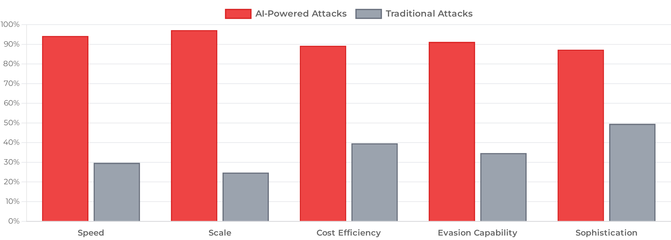
The Adversarial Advantage
AI-Powered vs Traditional Attack Capabilities
Key Insight: AI attacks scale exponentially; human defenses scale linearly

Slide 7

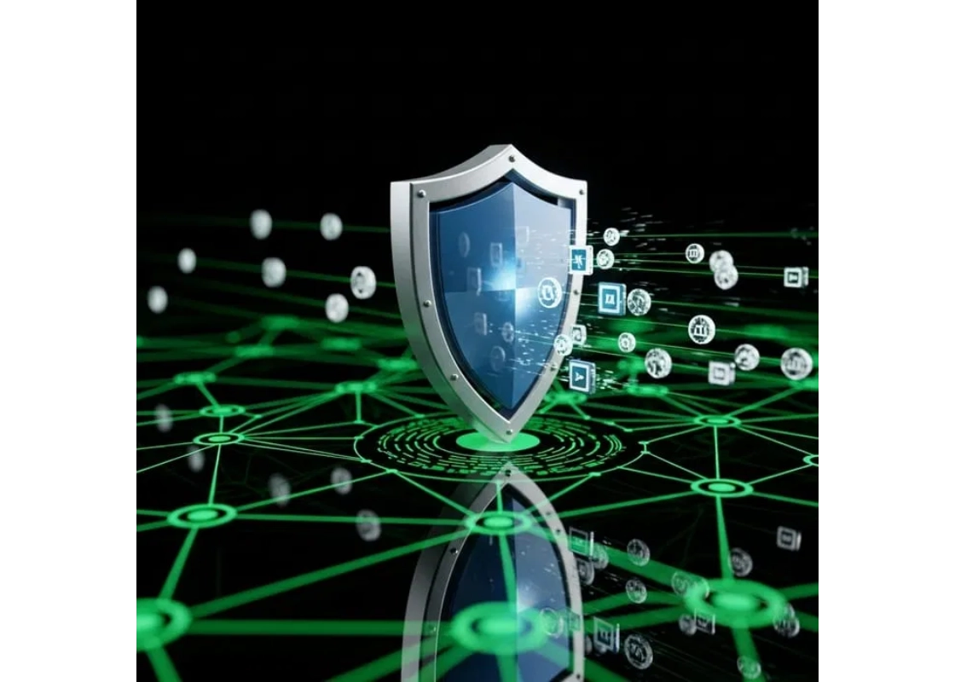



AI as Ally: The Defense Imperative
Human-only security operations cannot match AI-powered threats
AI Defense: Not Optional - Essential for Survival
Real-Time Threat Detection
Behavioral Analytics
Analyze billions of events simultaneously
Detect anomalies and zero-day attacks
Automated Response
Predictive Intelligence
React at machine speed, not human pace
Anticipate threats before they materialize

Slide 8





AI Defense Mechanisms
Real-Time Threat Detection
Analyze billions of events simultaneously to identify threats as they emerge
Behavioral Analytics
Detect anomalies and zero-day attacks through pattern recognition and machine learning
Automated Response
React at machine speed, not human pace, to contain and neutralize threats instantly
Predictive Intelligence
Anticipate future attack vectors and proactively strengthen defenses

Slide 9





Business Risk & Governance Transformation
Board-Level Concern
91% of organizations expect catastrophic AI-related events within 2 years
AI security elevated from IT issue to strategic business risk requiring executive oversight
Regulatory Compliance
EU AI Act, SEC disclosure requirements, and emerging global frameworks
Organizations must demonstrate AI governance, risk assessment, and security controls
Investment Requirements
$235B AI cybersecurity market by 2032 (31.7% annual growth)
Significant capital allocation required for AI defense infrastructure and expertise

Slide 10

Why This is THE Most Influential Trend
1
Asymmetric Threat Advantage
2
Defensive Necessity
AI enables attackers to operate at unprecedented scale and sophistication with minimal resources
Human-only defenses cannot match AI-powered threats; AI defense is essential for organizational survival
3
Regulatory Transformation
4
Business Model Impact
EU AI Act, SEC disclosure requirements, and global regulations mandate AI governance frameworks
AI security directly affects revenue, operations, customer trust, and competitive positioning
5
Skills Gap Solution
6
Investment Driver
AI addresses critical cybersecurity talent shortage by augmenting human capabilities at scale
$235B market by 2032 reflects massive capital allocation and strategic prioritization
7
Board-Level Elevation
91% of executives expect catastrophic events, elevating AI security to C-suite and board priority

Slide 11

Synthesis: THE Most Influential Trend
AI security is not just another trend but a fundamental transformation affecting every aspect of organizational operations, governance, and strategy through 2030
Existential Threat
Defensive Imperative
Regulatory Force
Creates asymmetric advantage for attackers that cannot be countered with traditional defenses
Organizations must adopt AI defense or face inevitable compromise
EU AI Act, SEC disclosure rules mandate compliance and governance
Business Impact
Workforce Evolution
Board-Level Priority
$235B market by 2032 drives massive investment and strategic priority
Addresses critical skills gap while transforming security operations
91% expect catastrophic events - elevates security to executive concern
This creates an existential imperative that organizations cannot ignore - making AI security THE defining trend in Security and Risk Management through 2030

Slide 12

Conclusion & Immediate Actions
The AI Security Paradox Defines the Future of SRM
IMMEDIATE ACTIONS REQUIRED
1
Assess AI attack surface and vulnerability exposure
2
Implement AI-powered defense systems and threat detection
3
Establish AI governance frameworks and risk management policies
4
Invest in AI security capabilities and infrastructure
5
Develop AI security expertise and upskill security teams
6
Elevate AI security to board-level strategic priority
Organizations that fail to embrace AI as both adversary and ally will face existential risks in the 2025-2030 landscape

Slide 13
List of References:
Abbas, N.N., Ahmad, R., Qazi, S. and Ahmed, W. (2025) 'Managing deepfakes with artificial intelligence: Introducing a business privacy calculus model', Journal of Business Research, 171, Article 105149. doi: 10.1016/j.jbusres.2024.105149
Abdullahi, M., Baashar, Y., Alhussian, H., Alwadain, A., Aziz, N., Capretz, L.F. and Abdulkadir, S.J. (2024) 'Towards a conceptual framework for AI-driven anomaly detection in smart city IoT networks', Journal of Innovation and Entrepreneurship, 13(1), Article 65. doi: 10.1186/s13731-024-00409-3
Abohany, A.A. (2024) 'Advancing cybersecurity: a comprehensive review of AI-driven detection techniques', Journal of Big Data, 11, Article 94. doi: 10.1186/s40537-024-00957-y
Ajayi, A.M., Omokanye, A.O., Olowu, O., Adeleye, A.O., Omole, O.M. and Wada, I.U. (2024) 'Detecting insider threats in banking using AI-driven anomaly detection: A data science approach', World Journal of Advanced Research and Reviews, 24(3), pp. 891-904. doi: 10.30574/wjarr.2024.24.3.3847
Akhunzada, A., Gani, A., Anuar, N.B., Abdelaziz, A., Khan, M.K., Hayat, A. and Khan, S.U. (2025) 'Generative AI: a double-edged sword in the cyber threat landscape', Artificial Intelligence Review, 58, Article 133. doi: 10.1007/s10462-025-11285-9
BCG (Boston Consulting Group) (2024) AI Adoption in 2024: 74% of Companies Struggle to Achieve and Scale Value. Press Release, 24 October. Available at: https://www.bcg.com/press/24october2024-ai-adoption-in-2024-74-of-companies-struggle-to-achieve-and-scale-value (Accessed: 10 October 2025).
Cyber Defense Magazine (2025) 'The Growing Threat of AI-powered Cyberattacks in 2025', Cyber Defense Magazine, 14 June. Available at: https://cyberdefensemagazine.com/the-growing-threat-of-ai-powered-cyberattacks-in-2025 (Accessed: 10 October 2025).
DelMorgan & Co. (2025) Cybersecurity Sector: A Strategic Investment in an Uncertain World. Investment Analysis Report, 29 July. Available at: https://delmorganco.com/cybersecurity-investment-trends-2025/ (Accessed: 10 October 2025).
Edim, E.B., Udofot, A.I. and Oluseyi, O.M. (2024) 'AI-augmented cyber security threat intelligence: Enhancing situational awareness', International Journal of Scientific Research Archive, 13(2), pp. 1842-1855. doi: 10.30574/ijsra.2024.13.2.2650
European Union (2024) 'Regulation (EU) 2024/1689 of the European Parliament and of the Council of 13 June 2024 laying down harmonised rules on artificial intelligence (Artificial Intelligence Act)', Official Journal of the European Union, L 1689, 1 August. Available at: https://artificialintelligenceact.eu (Accessed: 10 October 2025).

Slide 14
Fortune Business Insights (2025) Artificial Intelligence in Cybersecurity Market Size, Share & Industry Analysis, By Component (Solution and Services), By Security Type (Network Security, Endpoint Security, Application Security, and Cloud Security), By Deployment (Cloud and On-premises), By Enterprise Size (Large Enterprises and SMEs), By End-user (BFSI, Government, Healthcare, Retail, IT & Telecom, Manufacturing, and Others) and Regional Forecast, 2025-2032. Market Research Report FBI104348, August. Available at: https://www.fortunebusinessinsights.com/artificial-intelligence-in-cybersecurity-market-113125 (Accessed: 10 October 2025).
G7 Cyber Expert Group (2025) Statement on Artificial Intelligence and Cybersecurity. 6 October. Available at: https://www.regulationtomorrow.com/eu/managing-ai-related-cyber-risks/ (Accessed: 10 October 2025).
ISACA (2024) Understanding the EU AI Act. White Paper, July. Available at: https://www.isaca.org/resources/white-papers/2024/understanding-the-eu-ai-act (Accessed: 10 October 2025).
KnowBe4 (2025) Phishing Threat Trend Report: New KnowBe4 Report Reveals a Spike in Ransomware Payloads and AI-Powered Polymorphic Phishing Campaigns. Annual Report. Available at: https://www.knowbe4.com/press/new-knowbe4-report-reveals-a-spike-in-ransomware-payloads-and-ai-powered-polymorphic-phishing-campaigns (Accessed: 10 October 2025).
McKinsey & Company (2025) 'The State of AI: Global survey', QuantumBlack AI by McKinsey, 12 March. Singla, A., Sukharevsky, A., Yee, L., Chui, M. and Hall, B. Available at: https://www.mckinsey.com/capabilities/quantumblack/our-insights/the-state-of-ai (Accessed: 10 October 2025).
Mohamed, N. (2025) 'Artificial intelligence and machine learning in cybersecurity: State-of-the-art, challenges, and future directions', Knowledge and Information Systems, 67, pp. 3201-3251. doi: 10.1007/s10115-025-02429-y
NIST (National Institute of Standards and Technology) (2023) AI Risk Management Framework (AI RMF 1.0). NIST AI 100-1. Gaithersburg, MD: National Institute of Standards and Technology. Available at: https://www.nist.gov/itl/ai-risk-management-framework (Accessed: 10 October 2025).
NIST (2024) Artificial Intelligence Risk Management Framework: Generative AI Profile. NIST AI 600-1. Gaithersburg, MD: National Institute of Standards and Technology. Available at: https://www.nist.gov/itl/ai-risk-management-framework (Accessed: 10 October 2025).
Oloyede, J. (2024) 'AI-Driven Cybersecurity Solutions: Enhancing Defense Mechanisms in the Digital Era', SSRN Electronic Journal, Article ID 4976103. doi: 10.2139/ssrn.4976103
Ovabor, K. (2024) 'AI-driven threat intelligence for real-time cybersecurity: Frameworks, tools, and future directions', Open Access Research Journal of Science and Technology, 11(1), pp. 001-014. doi: 10.53022/oarjst.2024.11.1.0135

Slide 15
Palo Alto Networks (2024) 'The Dark Side of AI in Cybersecurity: AI-Generated Malware', Unit 42 Research Blog, 15 May. Matalon, B. and Dudas, R. Available at: https://www.paloaltonetworks.com/blog/2024/05/ai-generated-malware/ (Accessed: 10 October 2025).
PurpleSec (2025) PromptLock: The First AI-Powered Ransomware Prototype - Breach Report. August. Firch, J. Available at: https://purplesec.us/breach-report/promptlock-ai-ransomware/ (Accessed: 10 October 2025).
Ramadhani, K.N., Munir, R. and Utama, N.P. (2025) 'Unmasking digital deceptions: An integrative review of deepfake detection, multimedia forensics, and cybersecurity challenges', MethodsX, 14, Article 103088. doi: 10.1016/j.mex.2025.103088
World Economic Forum (2025) Global Cybersecurity Outlook 2025. In collaboration with Accenture. Geneva: World Economic Forum. Available at: https://www.weforum.org/publications/global-cybersecurity-outlook-2025/ (Accessed: 10 October 2025).

